Slide 1
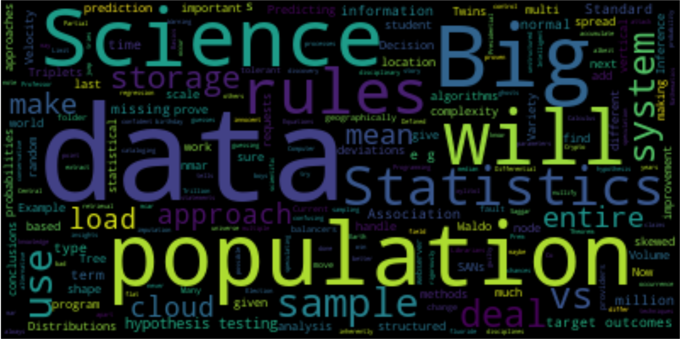
Data Science/AI Capabilities
Word cloud of this document

Slide 2





Professor Prem Saggar
Crypto

Slide 3

Twins, Triplets, and Crypto
Twins & Triplets all have the same birthday 4 years apart
All “6” boys
1/33*1/60,000*1/365 = 1/722 million <= chances < 1/33*1/200,000,000*1/365 = 1/2.4 Trillion
Co-occurrence? → 3,805,024,570 → 3,805,024,570 /722,700,000 = 5 others are possible in the world → 1 of 5 on Earth ☺ or 1/1 in maybe the universe

Slide 4
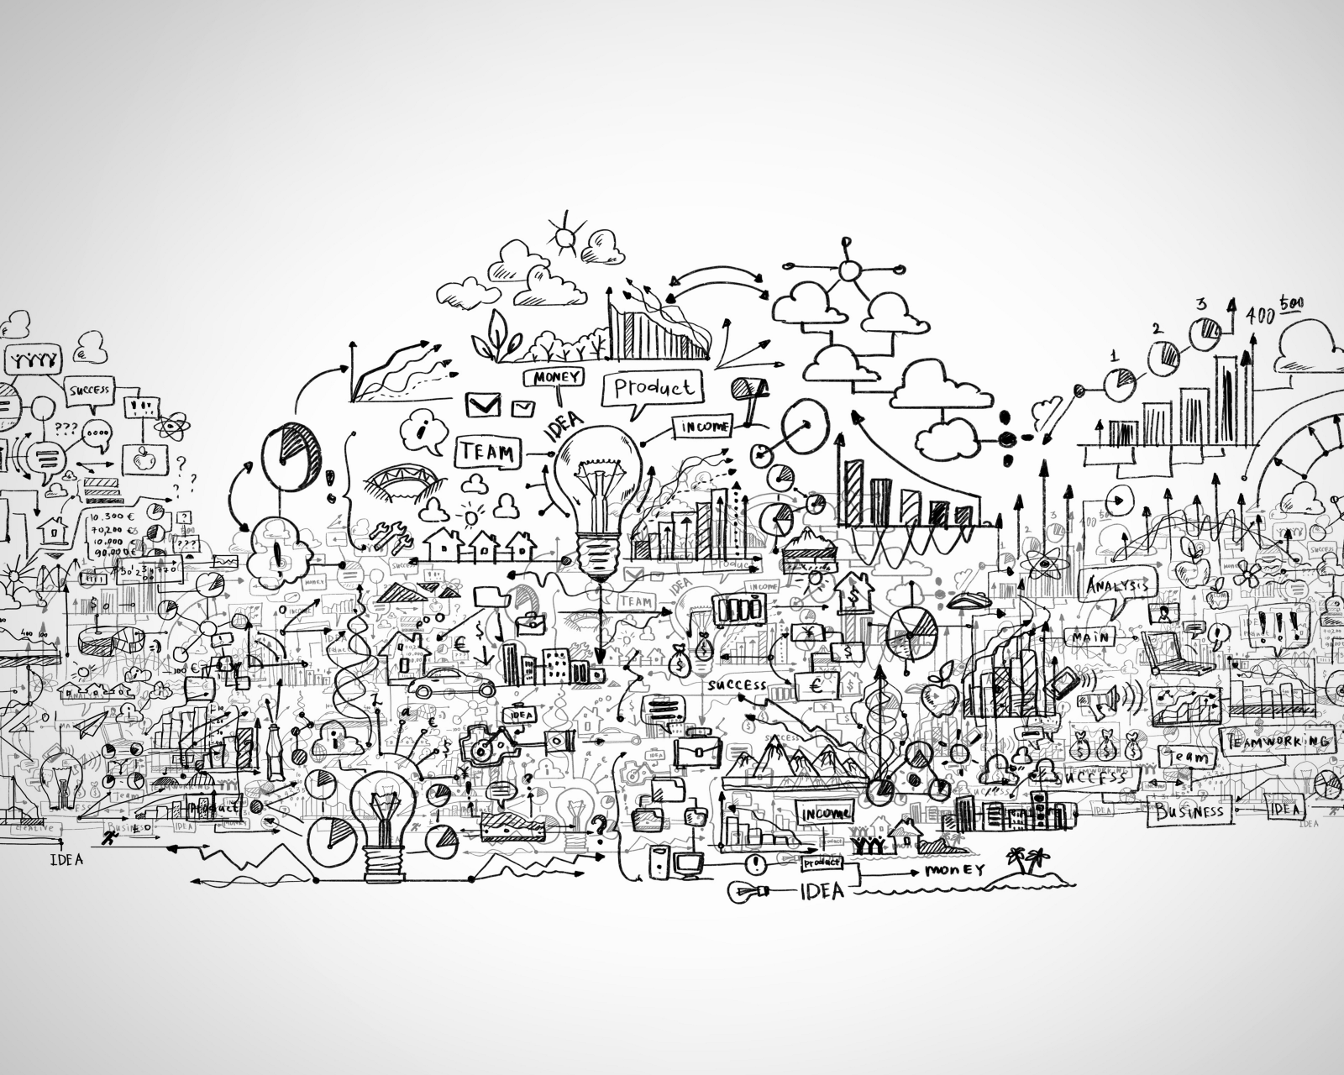

Slide 5
Data Science Defined
Data science is a multi-disciplinary field that uses scientific methods, processes, algorithms and systems to extract knowledge and insights from structured and unstructured data.
The multiple disciplines are:
Mathematics
Calculus and Partial Differential Equations, …
Statistics
Distributions, missing data, regression techniques, predictions about a population based on a sample …
Computer Science
Programming, algorithms, complexity analysis, BIG DATA …
Information Science
Librarians, cataloging, information discovery, information retrieval, …

Slide 6
Basics of Statistics
Statistics is the science of making a prediction about an entire population based on a sample.
E.g.,
Predicting when the next attack will occur
Predicting who will win the next Presidential Election
How is this done? Through sampling, probabilities, and hypothesis testing.

Slide 7

Statistics = Use random samples to make confident statements about entire populations. Intelligent guesses/speculation.

Slide 8
Sample, shape, location, and spread
Sample = make sure it's random, handle missing data (mcar, mar, nmar), imputation methods. NMAR!
Shape = Is the data skewed, normal, or flat? If normal then we can use statistical analysis for normal distributions
Location = Where does the data accumulate? Is it skewed, if so the median tells a better story.
Spread = How much does the data differ? Standard deviations!

Slide 9
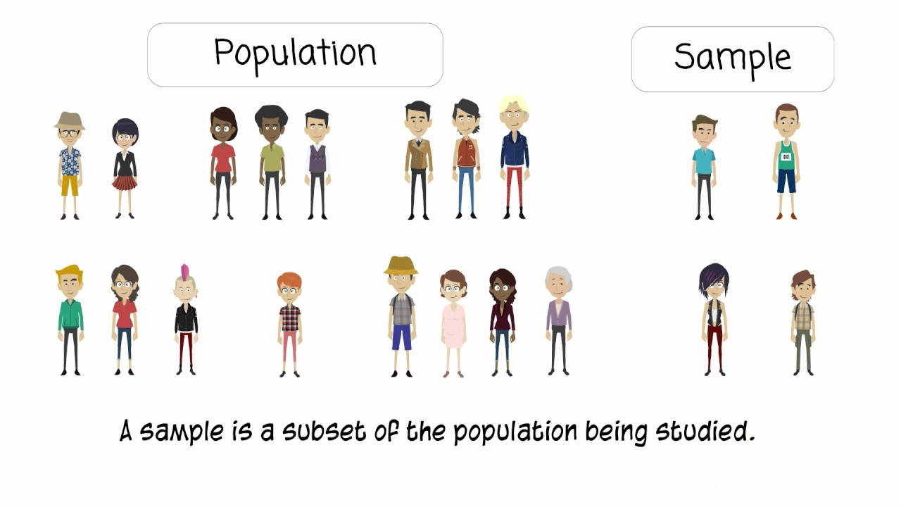
Samples give statistics, and populations (which we may never know give parameters)

Slide 10
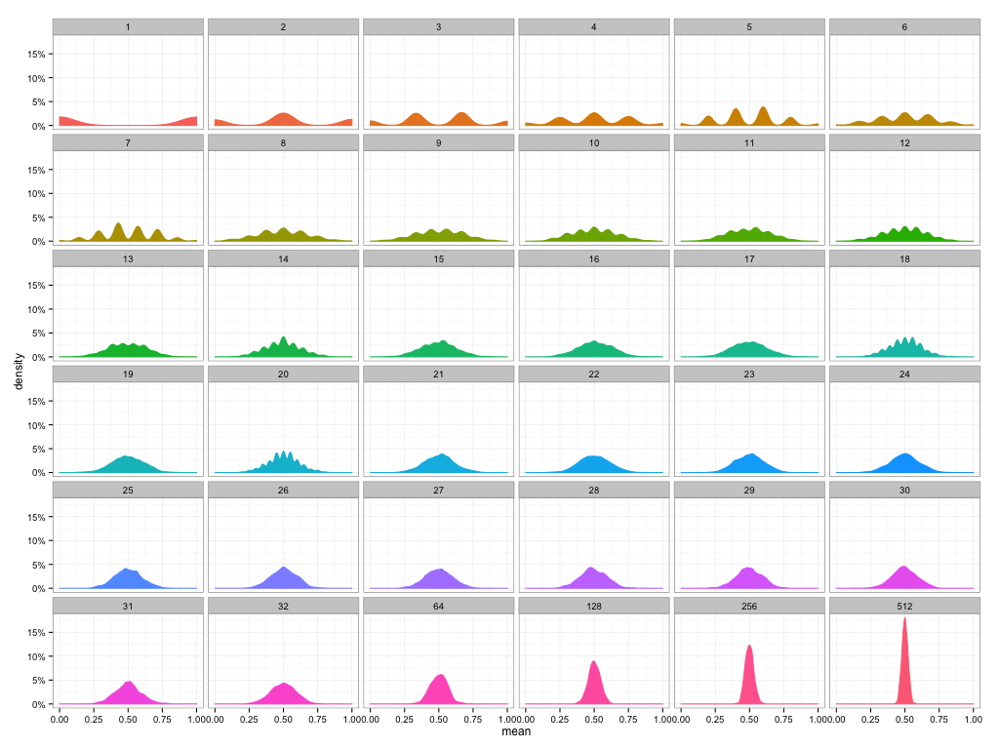
The Central Limit Theorem
If we:
Sample randomly
And use the averages of the sampled data
In the long term an n goes ballistic, the distribution will be normal and narrow. Why?

Slide 11
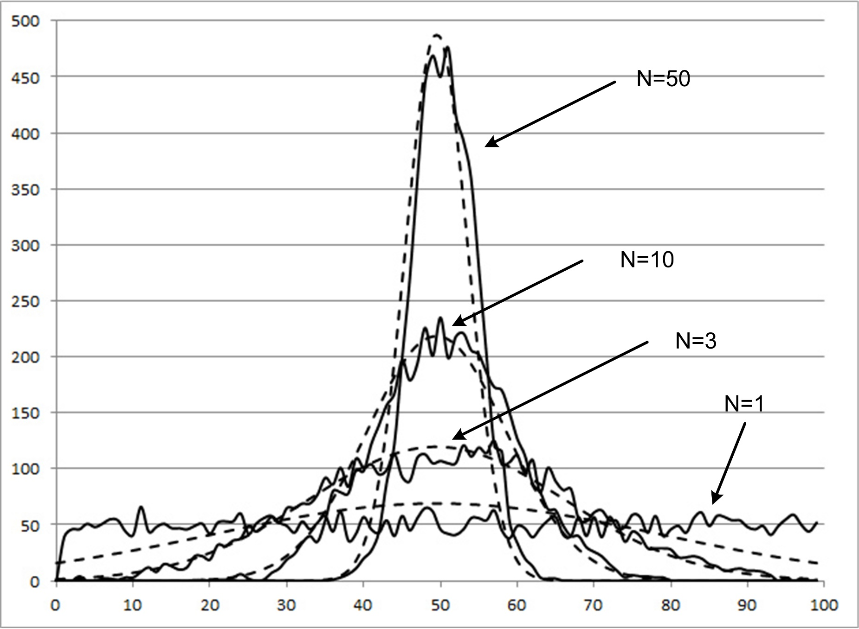

Slide 12
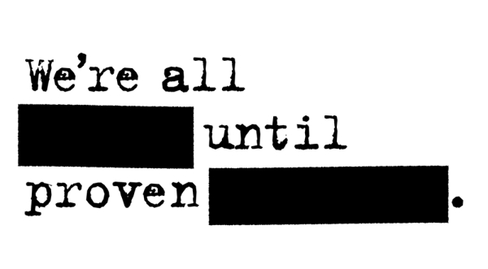

Slide 13
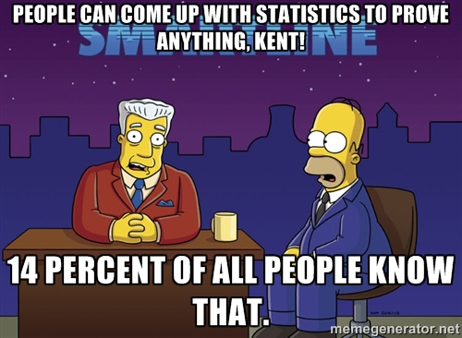
Hypothesis Testing

Slide 14

How do we prove our statistical claims?
Hypothesis Testing! The point of hypothesis testing is to make sure we don't jump to bad conclusions. Conclusions can be confusing (xylitol vs. fluoride). We are inherently speculating albeit rigorously. So we try to control the guessing by being conservative and use innocent until proven guilty.

Slide 15
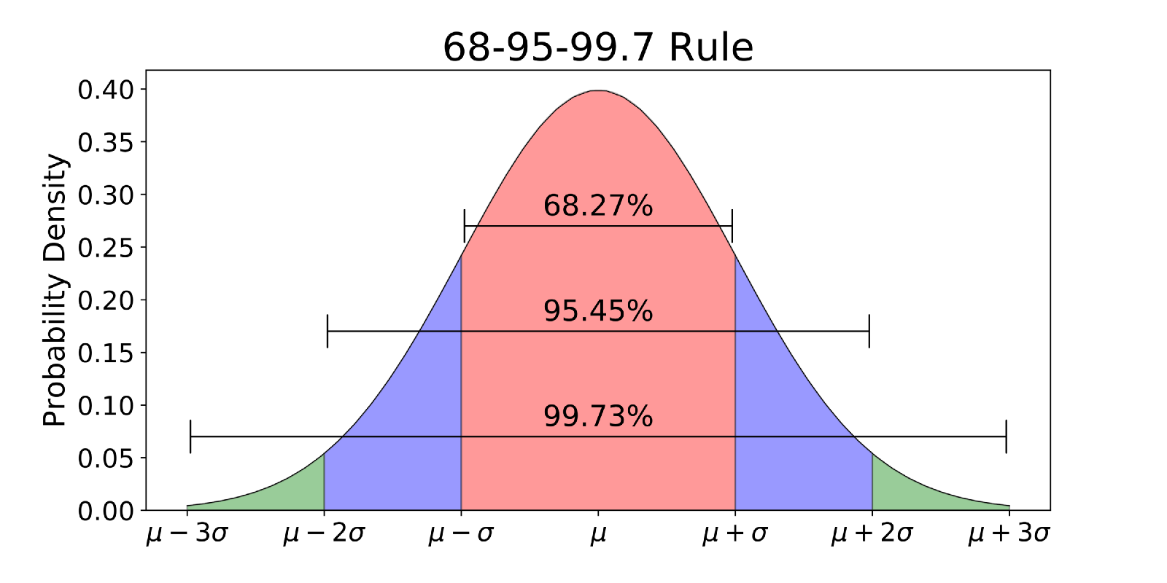
Standard deviations and probability of the population mean

Slide 16
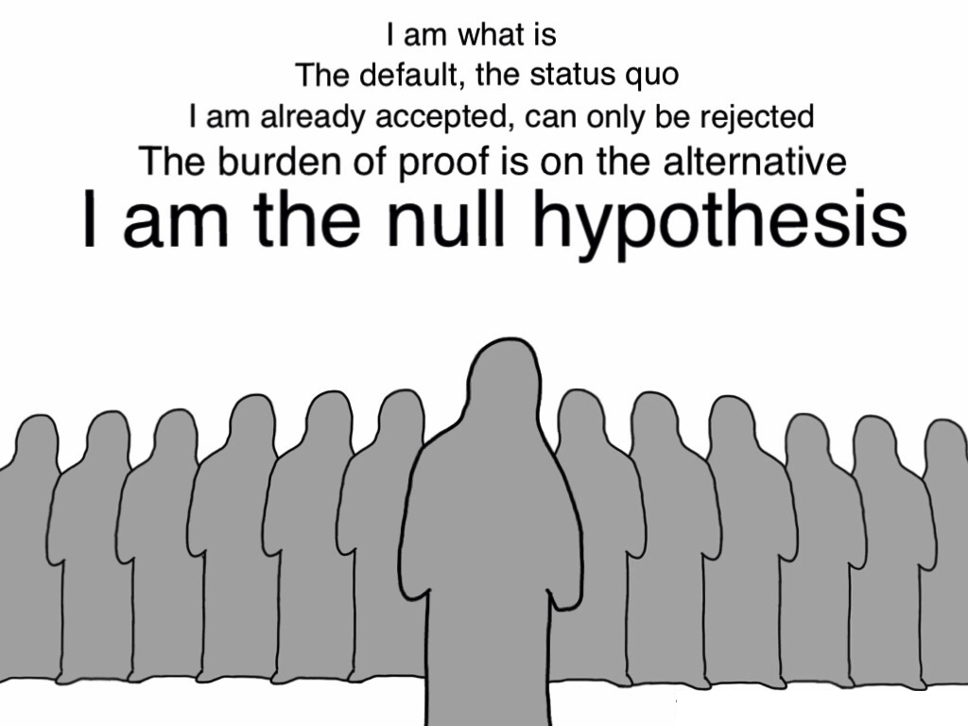

Slide 17

The alternative hypothesis tries to nullify the ghosts!

Slide 18
Warning
It's important to note that statistics and inferences about "populations" are always approximations. We aren't using probabilities when we do have the entire population e.g., the entire Data Science class is our population. Here I can get the population mean etc... No guess work is necessary. Now what if we said all data science students in the world currently? That’s much harder if not impossible. Inference time!

Slide 19
Survey
Assumption: student will find Waldo given enough time.
Student | Time to find Waldo | Maximum Time
 |  | 10
 |  | 10
 |  | 10
 |  | 10
 |  | 10

Slide 20
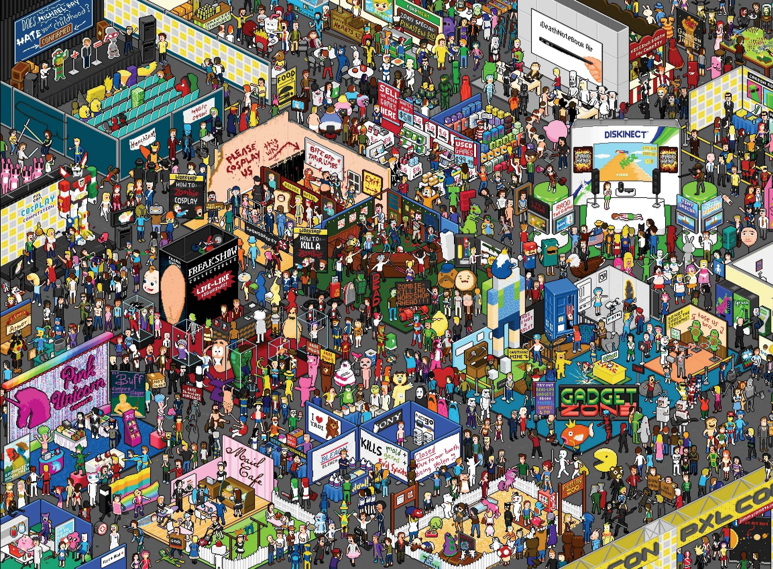
Where’s Waldo

Slide 21
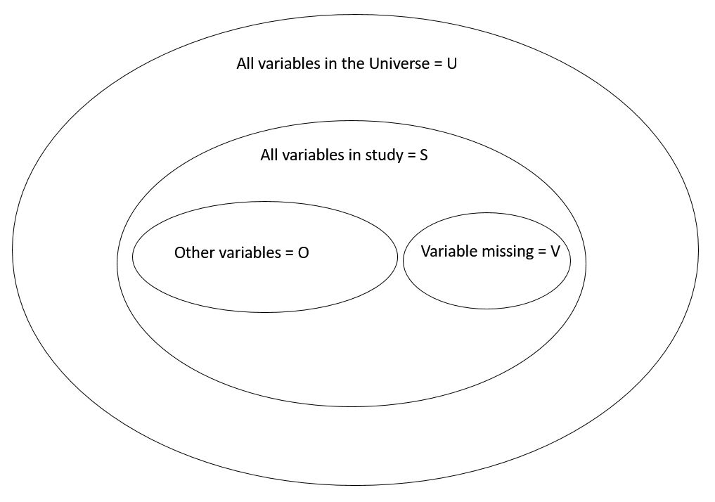

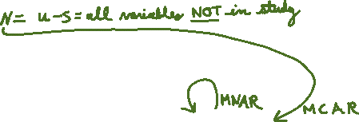
Missing data

Slide 22
Missing Data | Cause of missing | Example | Type | Impute outcome | Imputable | Action
V | N | Variable missing because of freak event, or any variable you did not model | MCAR | freak event is random, so imputation is not biased | TRUE | Rerun if possible
V | O | Variable missing because of variable(s) you DID model, e.g., blood not drawn by clinician so verdict not possible or unable to find something based on time | MAR | 50/50 chances for missing data is modelled so imputation is ok | TRUE | Rerun if possible
V | V | Variable missing because of the variable! I'm not telling you, e.g., what is your income | MNAR | skewed incomes everyone looks middle class | FALSE | Change survey

Slide 23


Slide 24
Unsupervised vs. Supervised Learning
Supervised learning is aided by training data and human correction.
Here’s some training data. Learn the patterns. Make your best guess at what the patterns are. We’ll feed you test data to figure out if you’ve understood it. If you stray off course, we’ll correct you and retrain.
Examples include Decision Trees and Neural Networks.
Unsupervised learning is uncorrected and runs on data. It can’t classify things “yet”. But is very good at clustering and anomaly detection.

Slide 25
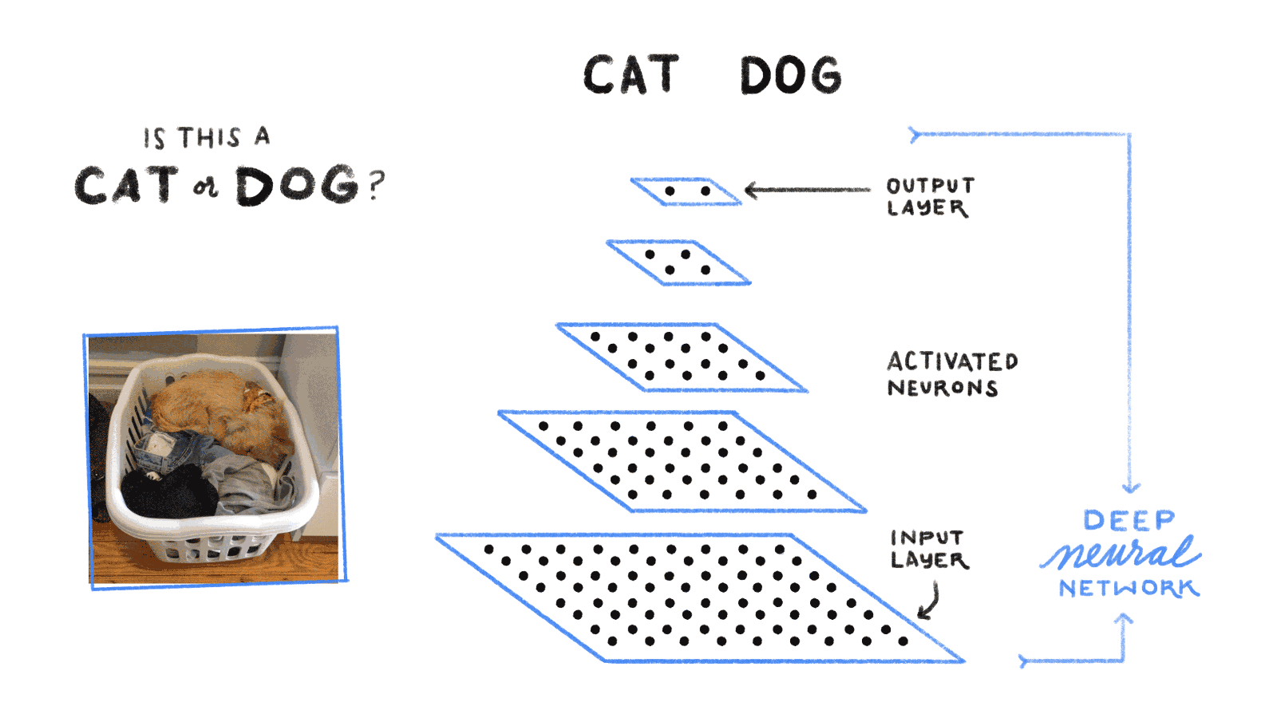
What’s “deep” about it?

Slide 26
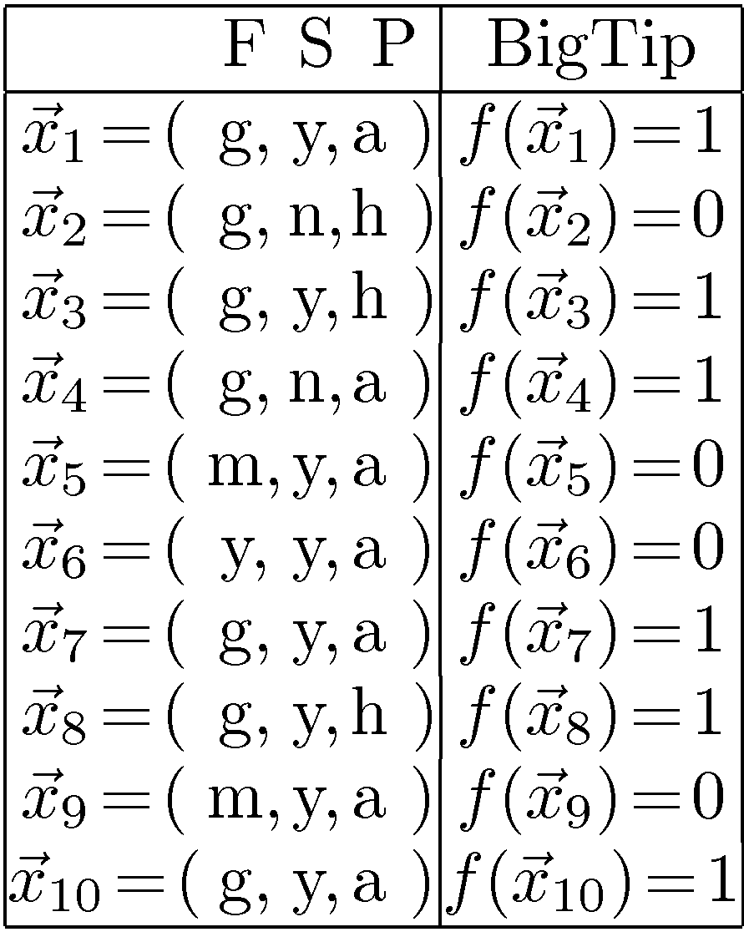
Decision Tree Example: “BigTip”
Great
Food
Yuck
Speedy
No
Mediocre
Yes
No
Our Data
Yes
No
Price
Adequate
High
Yes
No
Notes:
Definition of components
Internal nodes: tests on attributes
Branches: attribute value (one branch for each value)
Leaves: assign classification
Understanding example tree
Classify Example 1: yes
Classify Example 2: yes
Classify Example 3: no
Classify Example 4: yes
Classify: $x_2=(Food=great, Chat=no, Fast=no, Price=adequate, Bar=no)$ $\rightarrow$ yes
Example represents function: (Food=great) AND ((Fast=yes) OR ((Fast=no) AND (Price=adequate))) → Simplify to: (Food=great) AND ((Fast=yes) OR (Price=adequate))
How would you represent:
A AND B
A OR B
A XOR B

Slide 27
Association Rules!!!
Buying Pattern
Beer, Orange Juice, Diapers
Beer, Q-Tips, Diapers
Beer, Chips
Beer, Advil
Derived rules
Beer → Diaper 50% confidence
Diapers → Beer 100% confidence

Slide 28
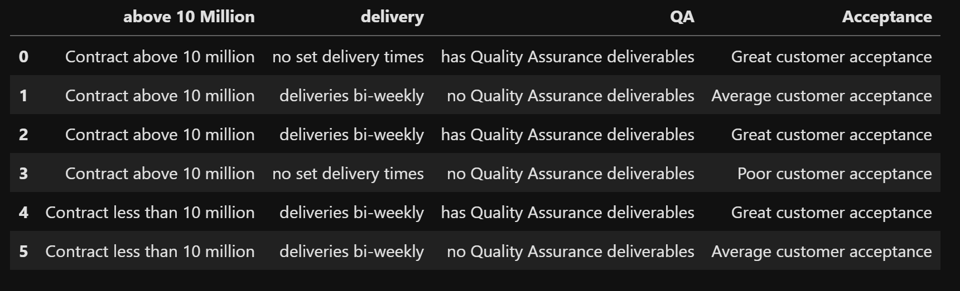
Association Rules example for financial transactions.
Please consider the following mock financial contract data. What patterns can we find for Great customer acceptance?
There are actually 190 rules we can derive and here are some key ones:
1) has Quality Assurance Deliverables → Great Customer acceptance @ 100% confidence (happens every time)
2) no Quality Assurance Deliverables → Average customer acceptance @ 66.7% confidence (happens 2 out of every 3 times)

Slide 29
What can we do with Association Rules?
Allow us to objectively report these are the rules within our data
Discover new behaviors we weren’t aware of
Finds rules with confidences that are not 100% but are still important
After examining the rules found we can say these are the target outcomes we’re interested in e.g., Great Customer Acceptance and Contracts less than 10 million.
Once we have target outcomes, we can use Decision Trees to illustrate and predict rules for these target outcomes.

Slide 30
Interview Problem for data scientists
Given the following:
3,6,4 = 18, 108, 648, 3888
2,-2,5 = -4,8,-16,32,-64
What is
2,3,4 = ?
Is there a formula for the last term?
Can you write a program to get the last term?
Can you prove your program works?
What is the time complexity?

Slide 31
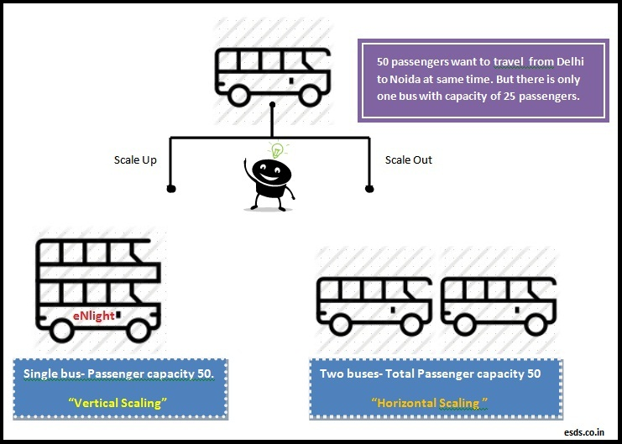
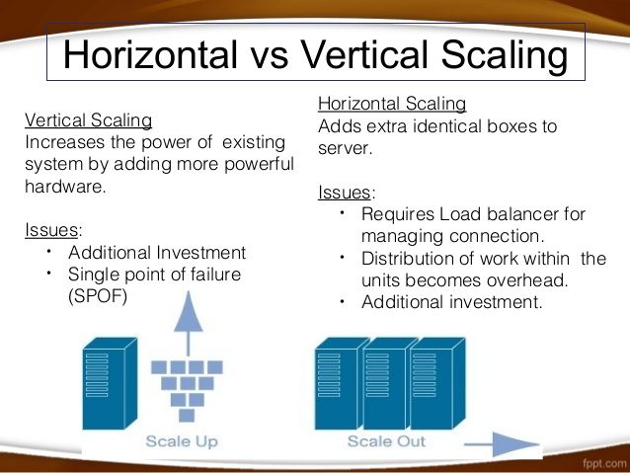
Big Data
What is Big Data? Is it Dangerous ☺?
Well what is Big?
Big is a relative term here and is assumed to be big by “today’s” standards. However, it really means too “big” for you to handle via vertical scaling. By vertical we mean single node improvement vs multi node horizontal improvement.

Slide 32
The 4 Vs of Big Data
Volume
How will your system deal with storage as data approaches ∞?
Velocity
How will your system deal with fast responses as requests approach ∞?
Variety
How will your system deal with different types of data as the types approach ∞?
Veracity
How will your system ensure the accuracy of your Big Data is not crushed as the other 3 Vs approach ∞?

Slide 33
Volume
Traditional approaches were to add more disks or (Storage area networks) SANs in data centers. This did not scale and the SANs were not geographically fault tolerant.
Current approach is to use Cloud storage that is practically limitless and is geographically fault tolerant. Many cloud storage providers exist making it financially practical to move storage to the cloud.

Slide 34
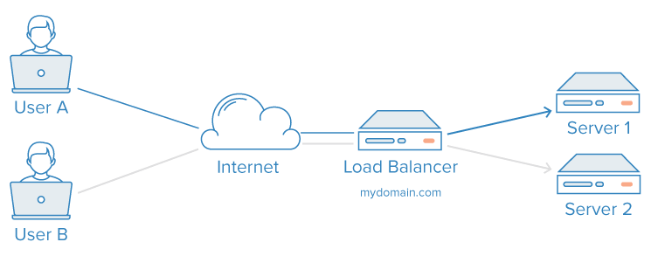
Velocity
How do we deal with millions → infinite concurrent requests?
Traditionally we’d add load balancers and scale up the webserver.
Now cloud providers have geographic load balancers (that are themselves load balanced) and webservers that are horizontally scaled

Slide 35
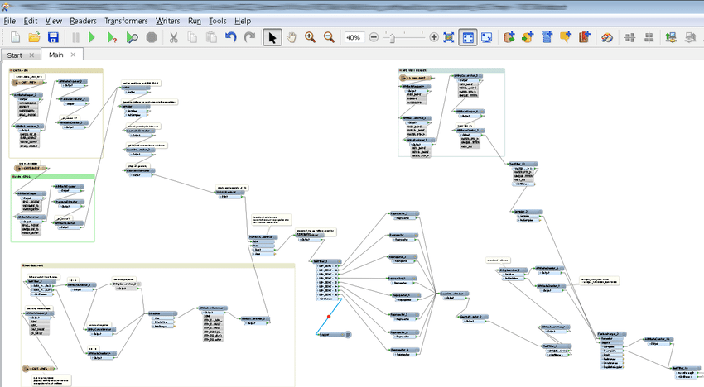
Variety
How do we deal with data changing and different data sets?
Relational databases tend to crack with many changes (ultra structured so change is costly)
Extraction, Transform, and Load (ETL) is cumbersome and expensive to run when data moves or is changed?
Current solutions make data formatting easy and impose minimal structure (put this type of data in this folder).
Data Lake → Folders ←→ Tables

